Slide 1
INTRODUCTION TO TIME SERIES ANALYSIS -II

Slide 2
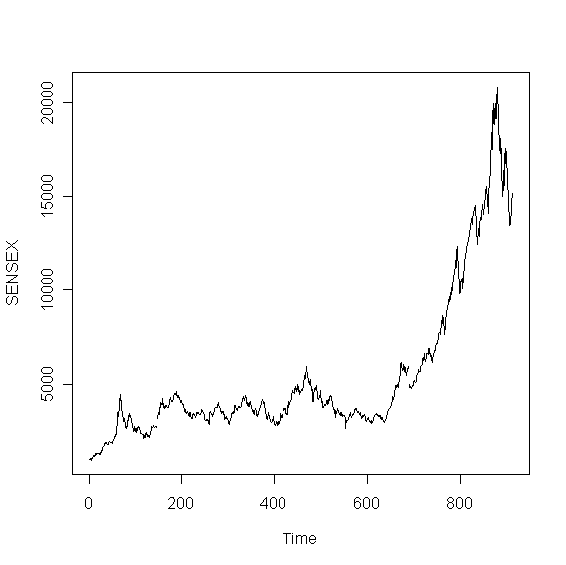
Recap: What is Time Series?
Time Series is a sequence of values measured over time.
Time series can be
Annual- ( GDP, Company Turnover)
Quarterly-(GDP, Company Turnover)
Monthly-( Inflation Rates)
Daily-(Stock prices, Gold Prices)

Slide 3
Recap: Time Series Data Analysis
Analyze trend and seasonality present in the data.
Decompose time series into its components.
Forecast future values of the time series.

Slide 4
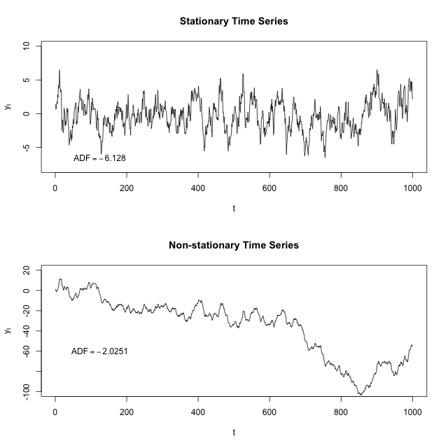
Recap: Stationary Time Series
Time series process is called stationary if the statistical properties of the process remain unchanged over time.

Slide 5
Recap:How to Make a Non Stationary Time Series Stationary?
There are 2 methods to make a non stationary time series stationary.
Differencing
De-trending
Differencing: A non stationary time series can be made stationary by differencing. Consider the following non- stationary process
Y_{t}=Y_{t-1}+U_{t} t=1,2,3…..
We assume that U_{t} is a random series with constant mean μ and constant variance σ² also it is serially uncorrelated i.e (U_{t} is stationary).
Hence Y_{t}-Y_{t-1}=ΔY_{t} = U_{t} , which is a stationary time series.
Differencing can be well applied in case of stochastic time series.

Slide 6
Recap: Identifying Stationary Time Series
Methods
Graphical
Analytical
Correlogram
D-F test

Slide 7
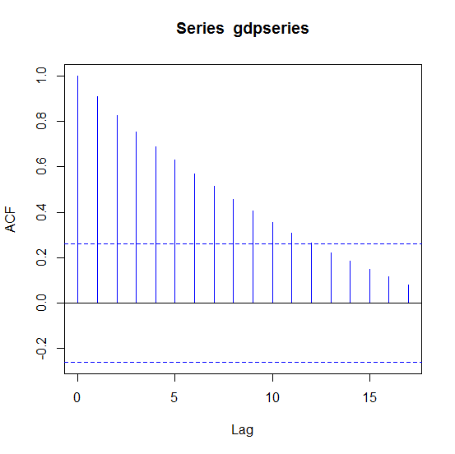
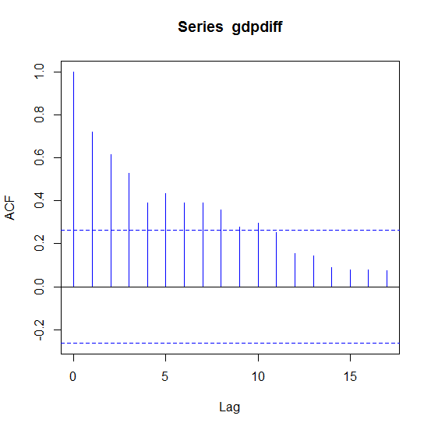
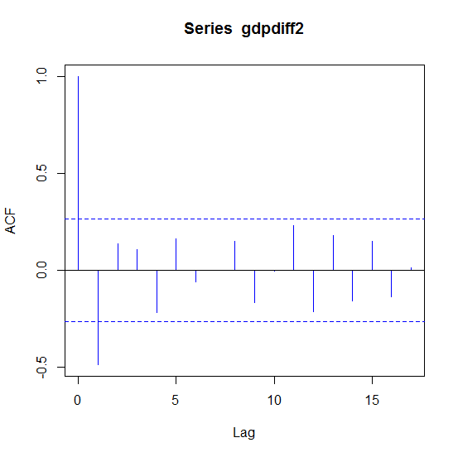
Recap: Time Series Analysis in R
Correlograms
Stationarity is achieved with second order difference

Slide 8
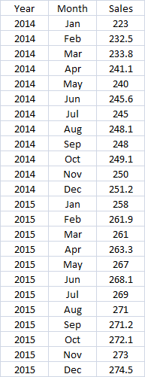
Monthly Sales Data 2014-2015
Sales figures (in Rs. Millions)
for 2 years.

Slide 9
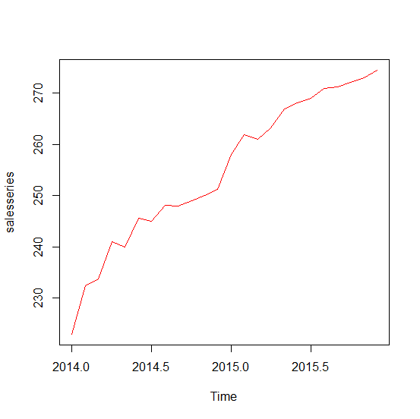
Time Series Analysis in R
Plot Time Series…
salesdata<-read.csv(file.choose(),header=T)
#Create time series object and plot. Frequency=12 indicates monthly data
salesseries<-ts(salesdata$Sales,start=c(2014,1),end=c(2015,12),frequency=12)
plot(salesseries,col="red")
Clearly a non stationary time series

Slide 10
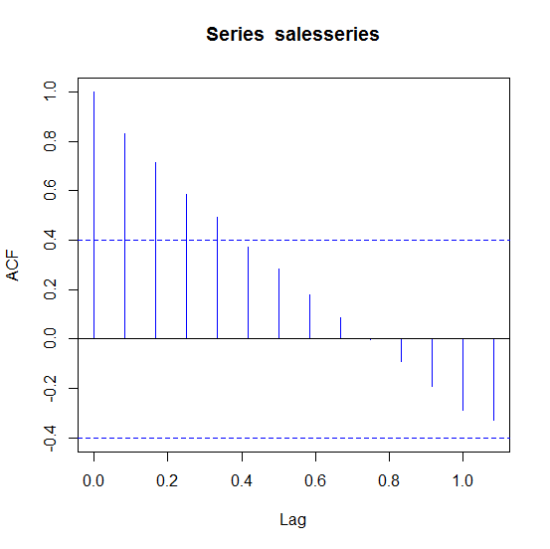
Time Series Analysis in R
Correlogram
#Obtain correlogram
acf(salesseries,col="blue")
 | Comp.1 | Comp.2 | Comp.3 | Comp.4 | Comp.5 | Comp.6 | Comp.7 | Comp.8
Standard deviation | 2.5741 | 0.9355 | 0.3982 | 0.3522 | 0.2829 | 0.2603 | 0.2148 | 0.1499
Proportion of Variance | 0.8282 | 0.1094 | 0.0198 | 0.0155 | 0.0100 | 0.0085 | 0.0058 | 0.0028
Cumulative Proportion | 0.8282 | 0.9376 | 0.9574 | 0.9729 | 0.9830 | 0.9914 | 0.9972 | 1.0000
Slow decay confirms
non stationarity

Slide 11
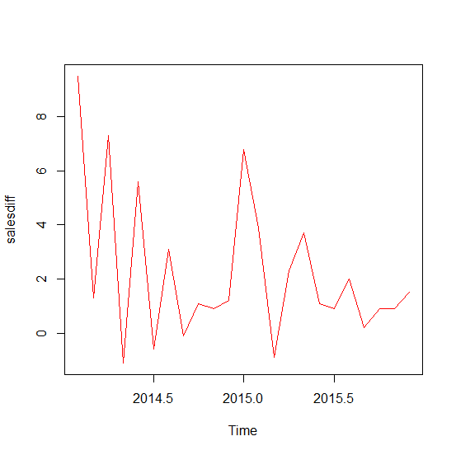
Time Series Analysis in R
Plot Difference Time Series
salesdiff<-diff(salesseries,differences=1)
plot(salesdiff,col="red")
Looks first difference
is stationary

Slide 12
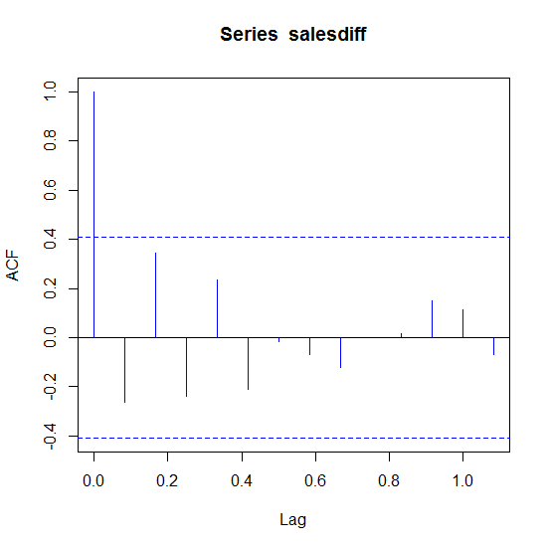
Time Series Analysis in R
Correlogram for Difference Time Series
acf(salesdiff,col="blue")
First difference is stationary time series

Slide 13
How Many Times Should Time Series Be Differenced to Make Stationary?
library(forecast)
ndiffs(salesseries)
> ndiffs(salesseries)
[1] 1
library(urca)
summary(ur.df(salesseries,lag=0))
Value of test-statistic is: 3.6856
Critical values for test statistics:
1pct 5pct 10pct
tau1 -2.66 -1.95 -1.6
summary(ur.df(salesdiff,lag=0))
Value of test-statistic is: -4.6349
Critical values for test statistics:
1pct 5pct 10pct
tau1 -2.66 -1.95 -1.6
H0: Time Series in Nonstationary
Do not reject H0
Reject H0 as value of test statistic is less than 5 pct critical value(-1.95)

Slide 14
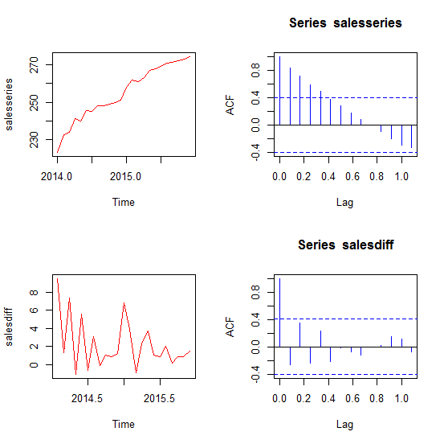
Showing Graphs in One Panel
par(mfrow=c(2,2))
plot(salesseries,col="red")
acf(salesseries,col="blue")
plot(salesdiff,col="red")
acf(salesdiff,col="blue")

Slide 15
Components of Time Series? Trend, Seasonality and Cyclic Pattern
Trend refers to the long-term increase or decrease in the time series.
Seasonality in a time series refers to predictable and recurring trends and patterns over a period of time, normally a year. An example of a seasonal time series is retail data, which sees spikes in sales during holiday seasons like Christmas or Diwali.
A cyclic pattern exists when data exhibits rises and falls that are not of fixed period. The duration of these fluctuations is usually of at least 2 years.

Slide 16
Time Series Decomposition
Time series can be considered as having three components:
Trend
Seasonal Component
Random Component
For example, if we assume an additive model, then we can write
Yt=St + Tt + Rt
where Yt is the data at period t, St is the seasonal component at period t, Tt is the trend component at period t and Rt is the remainder (or irregular or error) component at period t.

Slide 17
Time Series Decomposition
Alternatively, a multiplicative model would be written as
Yt=St * Tt * Rt
The additive model is most appropriate if the magnitude of the seasonal fluctuations or the variation around the trend-cycle does not vary with the level of the time series.

Slide 18
Time Series Decomposition
Step 1: Obtain moving averages covering one season. For example: In case on monthly data obtain average of 13 values (6 previous,6 post and given month value). This provides trend component of the time series.
Step 2: Eliminate trend component from original time series.
Calculate Yt –Tt
Step 3: To estimate the seasonal component for each month, simply average the detrended values for that month. For example, the seasonal index for March is the average of all the detrended March values in the data. These seasonal indexes are then adjusted to ensure that they add to zero.
The remainder component is calculated by subtracting the estimated seasonal and trend-cycle components.

Slide 19
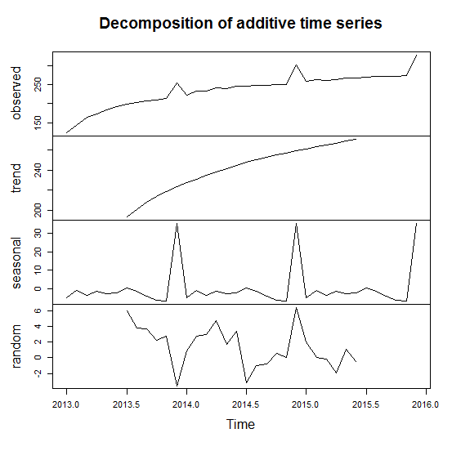
Time Series Decomposition in R
salesdata<-read.csv(file.choose(),header=T)
salesseries<-ts(salesdata$Sales,start=c(2013,1),end=c(2015,12),frequency=12)
decomp<-decompose(salesseries) # can specify type="multiplicative"
plot(decomp)
 | Comp.1 | Comp.2 | Comp.3 | Comp.4 | Comp.5 | Comp.6 | Comp.7 | Comp.8
Standard deviation | 2.5741 | 0.9355 | 0.3982 | 0.3522 | 0.2829 | 0.2603 | 0.2148 | 0.1499
Proportion of Variance | 0.8282 | 0.1094 | 0.0198 | 0.0155 | 0.0100 | 0.0085 | 0.0058 | 0.0028
Cumulative Proportion | 0.8282 | 0.9376 | 0.9574 | 0.9729 | 0.9830 | 0.9914 | 0.9972 | 1.0000
Trend not estimated
For first/last few values.
Assumes that the
seasonal component
repeats from year to year

Slide 20
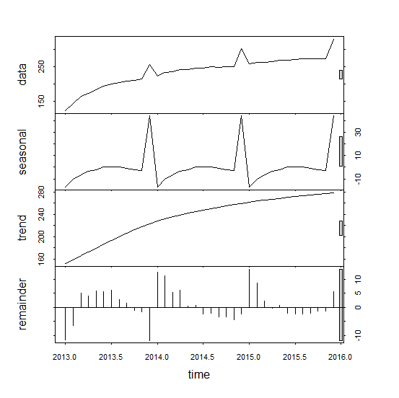
Time Series Decomposition in R
Local Regression Method (LOESS)
salesdata<-read.csv(file.choose(),header=T)
salesseries<-ts(salesdata$Sales,start=c(2013,1),end=c(2015,12),frequency=12)
decomp<-stl(salesseries,s.window="periodic")
plot(decomp)
STL is an acronym for
“Seasonal and Trend
decomposition using Loess”,
while Loess is a method for estimating nonlinear relationships.

Slide 21
THANK YOU!!

